Slide 1
PQ2016, Tallinn
Long-term impact of technological development on European road transportation sector’s fuel mix: focus on electric vehicles
Ekaterina Grushevenko
Energy research institute Russian Academy of Science
This work was supported by the Russian Science Foundation project №14-19-01459

Slide 2
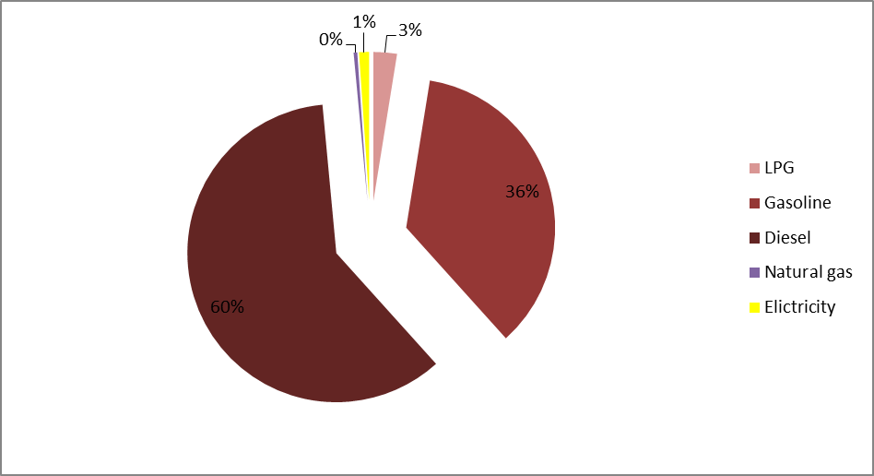
Current situation on European market
Road transportation sector accounted for about 24% of the European energy demand in 2013
Almost 100% of that demand was met by petroleum fuels, which were mostly imported
Road transportation fuel mix in Europe 2013
This factors create threats to European energy security

Slide 3
Electric vehicle is the option to reduce oil product import dependency
Electricity can be produced from different sources of energy including renewable energy
Electric motors are more efficient via internal combustion engine. Electric vehicles convert about 59%–62% of the electrical energy from the grid to power at the wheels—conventional gasoline vehicles only convert about 17%–21% of the energy stored in gasoline to power at the wheels
Charging infrastructure is safety and cheap
No CO2 emission from using EV

Slide 4
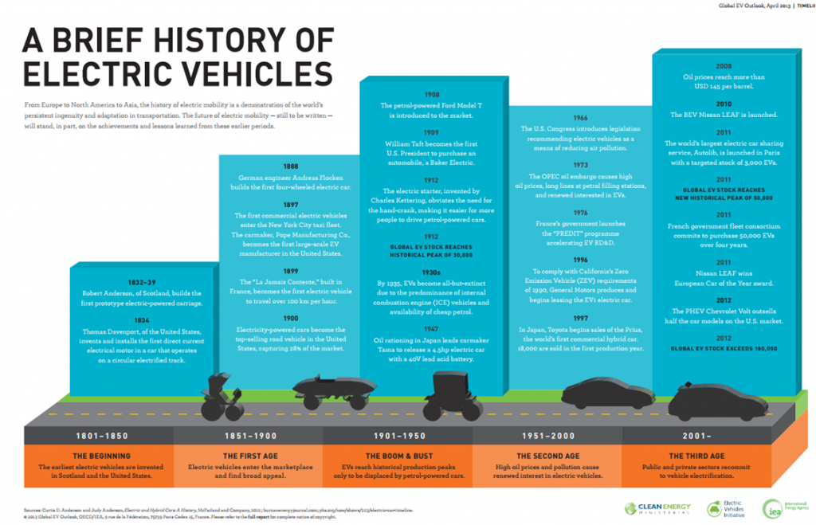

Slide 5
Scenario assumptions
Assumptions | Scenarios
 | Baseline scenario | Technological scenario
GDP growth rate | 1,5% | 1,7%
Liquid fuels (petroleum products and biofuels) | Current regulations of the petroleum market stay in place. Retail prices are closely correlated with global wholesale oil prices. Vehicles fuel efficiency increases twofold by 2040 compared to 2013. No significant increase in the ownership cost is expected.
Gas fuel | No large-scale gas vehicle manufacturing is established. No reduction in purchase price. Engines fuel efficiency increases twofold by 2040 in accordance with conventional (internal) combustion engines efficiency increase. Up to year 2025 infrastructure develops in line with current EU plans (2014/94/EU), and then continues to expand at the same pace until the year 2040, experiencing a threefold increase in number of CNG fueling stations.
Electricity | No breakthrough in the EV production is expected. Up to year 2025 infrastructure develops in line with current EU plans (2014/94/EU), and then continues to evolve at the same pace until the year 2040, experiencing a two-fold increase in number of EV chargers. | Due to significant technological progress in the EV production and expansion of production volume the cost of the acquisition by the year 2040 is reduced to the level of conventional vehicles. Charging infrastructure develops rapidly. The number of charging stations is increased 2.2-fold; technological capabilities of recharging are expanded.

Slide 6
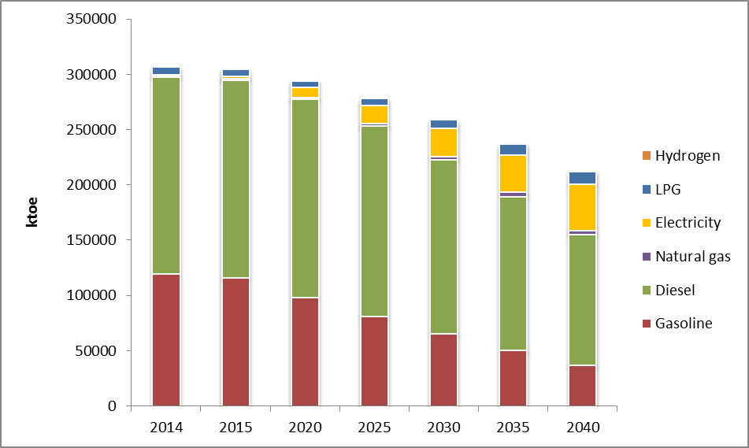
European transportation sector fuel mix. Baseline scenario
Even in the Base scenario, the share of electricity by 2040 will reach 20% of total road transportation fuel demand

Slide 7
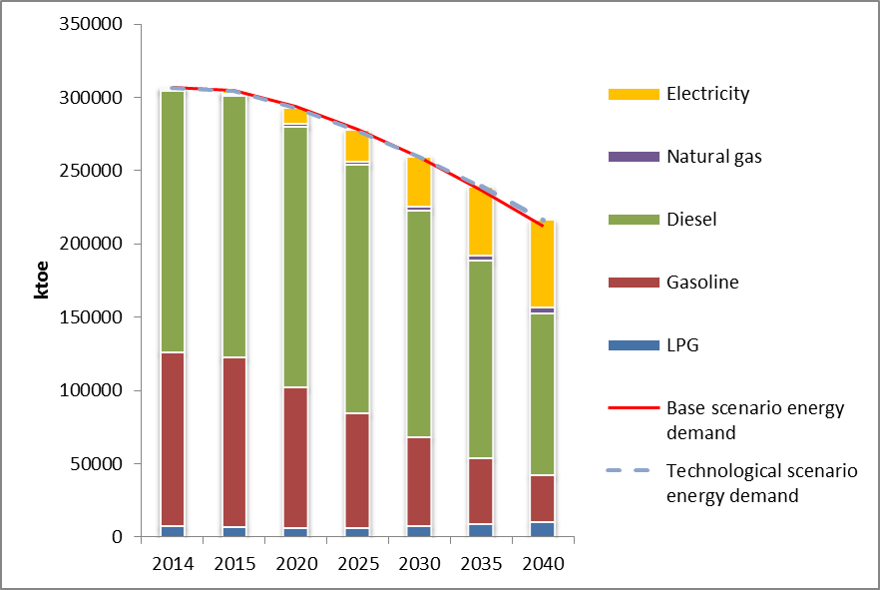
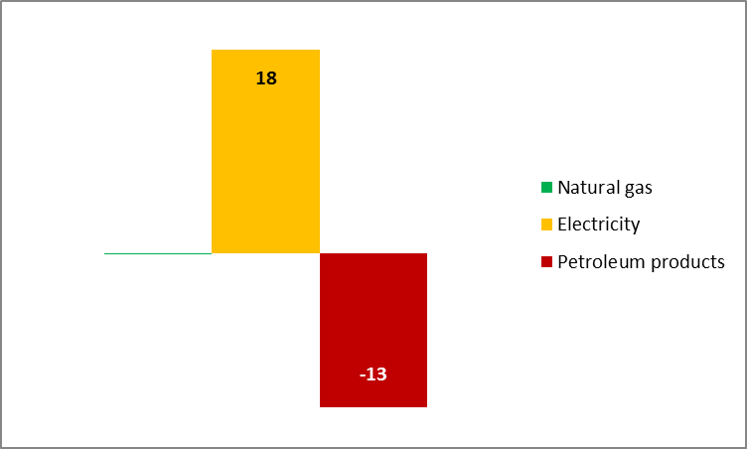
European transportation sector fuel mix. Technological scenario
European transportation sector fuel mix. Technological scenario
Difference between Technological and Baseline scenario, Mtoe
In the Technological scenario, the share of electricity by 2040 will reach 30%
Additional electricity will substitute petroleum products and natural gas

Slide 8
Reasons of why NGVs are not competitive in Europe:
Cost of NGVs and their maintenance is often higher than diesel or petrol vehicles
Switching to natural gas will not eliminate European import dependency and so far energy security issues
The most critical reason is infrastructure:
Building an natural gas filling station technically is more complicated than petrol station or Ev-charger
Petrol station and Ev-charger are safer than natural gas filling station
Cost of natural gas filling station is much higher than petrol station or Ev-charger (about 800-1000 k USD vs 300-500 k USD and 10-200 k USD respectively)

Slide 9
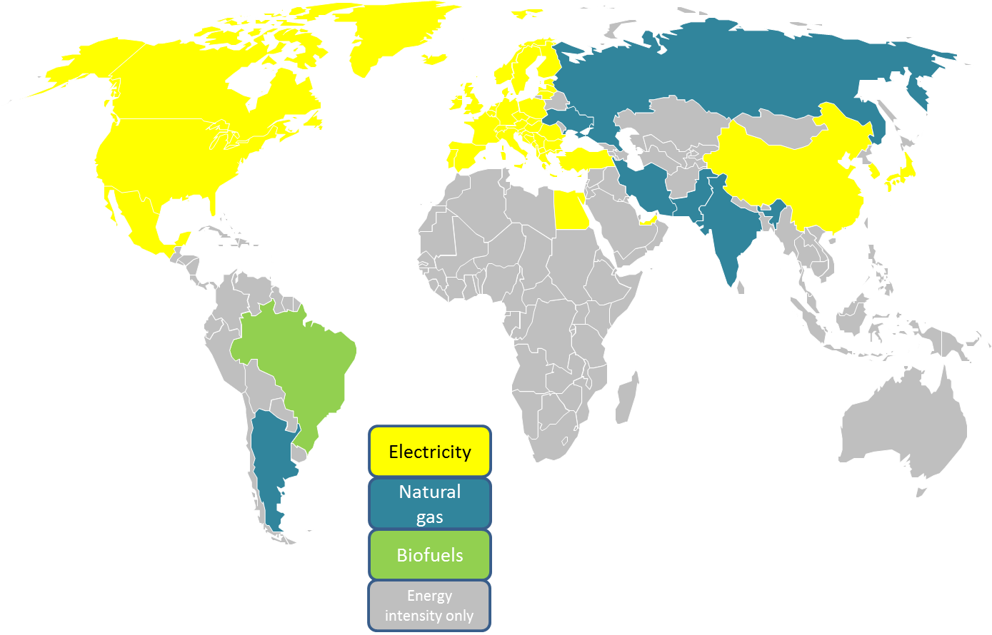
Substitution of petroleum products in the world
Electricity is the leading substitute of petroleum products

Slide 10
Conclusions
Petroleum fuels will still dominate till 2040 in European road transportation fuel mix
Electric vehicles have already found their niche in Europe: EVs energy consumption share in road transportation sector can reach from 20 to 30% in 2040 (10-15 GW*h or 40-60 Mtoe)
Natural gas amount does not change significant in both scenarios.
EVs are more competitive than natural gas.

